Slide 1

MARKET BASKET ANALYSIS
MADHU

Slide 2
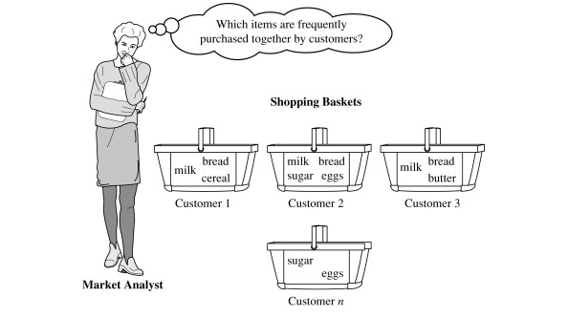
WHAT IS MARKET BASKET ANALYSIS?
This process finding customer buying habits.
That means different items that customer place in their shopping baskets as the following fig.
This kind of association will be help full retailer and marketers to develop marketing stratagies

Slide 3
1.Support
Its the default popularity of an item.
In mathematical terms, the support of item A is nothing but the ratio of transactions involving A to the total number of transactions.
Support (Biscuits) = (Transactions relating biscuits) / (Total transactions)
= 400/4000 = 10 percent.

Slide 4
2. Confidence:
Likelihood that customer who bought both A and B.
Its divides the number of transactions involving both A and B by the number of transactions involving B.
Confidence(A => B) = (Transactions involving both A and B)/(Transactions involving only A)
Confidence = (Transactions relating both biscuits and Chocolate) / (Total transactions involving Biscuits)
= 200/400
= 50 percent.
It means that 50 percent of customers who bought biscuits bought chocolates also.

Slide 5
3. Lift :
Increase in the sale of A when you sell B.
Lift(A => B) = Confidence(A, B) / Support(B)
Lift = (Confidence (Biscuits - chocolates)/ (Support (Biscuits)
= 50/10 = 5
So, likelihood of a customer buying both A and B together is ‘lift-value’ times more than the chance if purchasing alone.
Lift (A => B) = 1 means that there is no correlation within the itemset.
Lift (A => B) > 1 means that there is a positive correlation within the itemset, i.e., products in the itemset, A, and B, are more likely to be bought together.
Lift (A => B) < 1 means that there is a negative correlation within the itemset, i.e., products in itemset, A, and B, are unlikely to be bought together

Slide 6
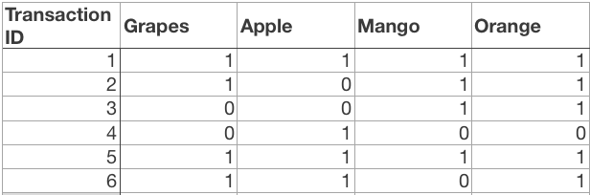
Apriori Algorithm
Apriori algorithm assumes that any subset of a frequent itemset must be frequent. Its the algorithm behind Market Basket Analysis.
Say, a transaction containing {Grapes, Apple, Mango} also contains {Grapes, Mango}. So, according to the principle of Apriori, if {Grapes, Apple, Mango} is frequent, then {Grapes, Mango} must also be frequent.
Here is a dataset consisting of six transactions. Each transaction is a combination of 0s and 1s, where 0 represents the absence of an item and 1 represents the presence of it.

Slide 7
Limitation of Apriori algorithm
Frequent Itemset Generation is the most computationally expensive step because the algorithm scans the database too many times, which reduces the overall performance. Due to this, the algorithm assumes that the database is Permanent in the memory.
Also, both the time and space complexity of this algorithm are very high: O(2^{|D|}), thus exponential, where |D| is the horizontal width (the total number of items) present in the database.

Slide 8
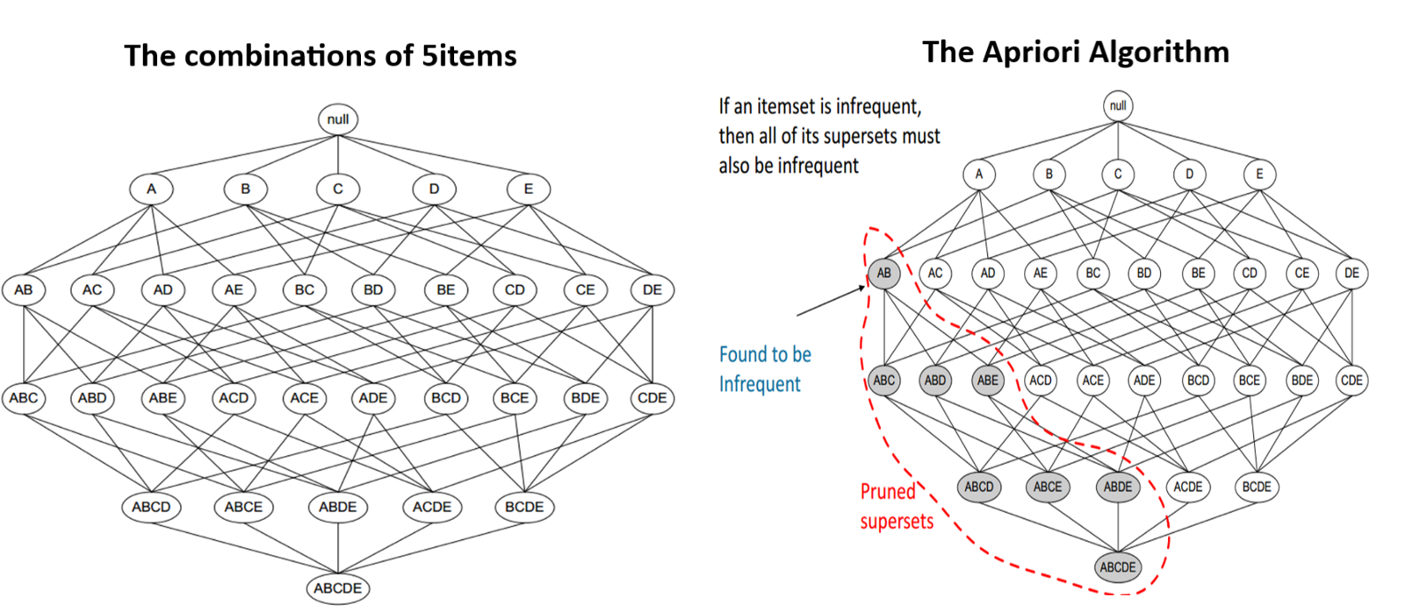
Optimizing Apriori algorithm

Slide 9
Transaction reduction
Transaction reduction: A transaction that does not contain any frequent k-itemsets useless in subsequent scans.
Partitioning: An itemset that is potentially frequent in DB must be frequent in at least one of the partitions of DB.
Sampling: Mining on a subset of given data, lower support threshold + a method to determine the completeness.
Dynamic itemset counting: add new candidate itemsets only when all of their subsets are estimated to be frequent.
Hash-based itemset counting: A k-itemset whose corresponding hashing bucket count is below the threshold cannot be frequent.

Slide 10
Advantages of Apriori Algorithm
It is used to calculate large itemsets.
Simple to understand and apply.

Slide 11
Disadvantages of Apriori Algorithms
Apriori algorithm is an expensive method to find support since the calculation has to pass through the whole database.
Sometimes, you need a huge number of candidate rules, so it becomes computationally more expensive.

Slide 12
Thank you
s

